Slide 1

Intro to Game Development
Get in touch: admissions@bitmakerlabs.com
Wifi: Bitmaker
Password: bitmaker0011

Slide 2


Slide 3

Lecture 3:
2D Rendering in Unity

Slide 4


Slide 5
2D Rendering in Unity

Slide 6
2D In Unity
Unity supports a robust 2D pipeline, with support for sprites, animations, 2D physics, and a flexible UI system.

Slide 7
The Scene Camera

Slide 8
The Scene Camera

Slide 9
The Scene Camera
Cameras are GameObjects that define “views” in scene space.
Transform of the camera defines its viewpoint and viewing direction.

Slide 10
Perspective vs Orthographic
Contents of world are flattened into screen space via “projection”. Unity’s default.
Two types of native projection:
Orthographic
Perspective

Slide 11
Perspective
Default projection. Used to simulate real-world vision, with objects further away appearing smaller in view
Important Parameters:
Field of View (fov), Near Plane (n)
Far Plane(f), Aspect Ratio (a)

Slide 12
Perspective

Slide 13
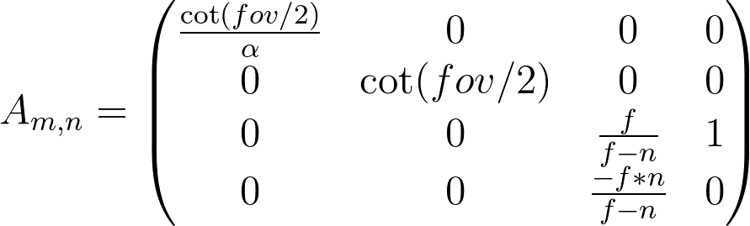
Perspective

Slide 14
Perspective

Slide 15
Orthographic
A form of parallel projection: all projected lines are orthogonal to the plane of projection. No perspective distortion is applied to the scene
Important Parameters:
Size (s), Aspect Ratio (a),
Near Plane (n), Far Plane (f)

Slide 16
Orthographic

Slide 17
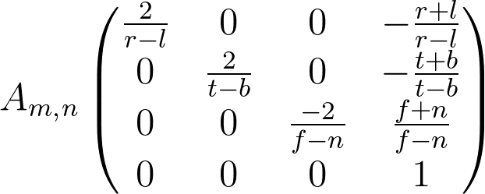
Orthographic

Slide 18
Orthographic

Slide 19
Side By Side

Slide 20
Orthographic & 2D
Most 2D games are projected orthographically.
This allows for depth sorting without scaling or distortion.
Some games use a combination of the two: Fez, Guilty Gear, etc.

Slide 21
Revisiting the Transform
Position, orientation and scale are represented internally by matrices
Matrices are NxM-dimensional arrays of numerical values that can be used to transform a point in space via multiplication

Slide 22
Revisiting the Transform
Position and scale are represented by Vectors.
Vectors are N dimensional arrays of values that can be used to represent a direction and a magnitude
(1, 1) unit vector

Slide 23
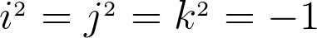
Revisiting the Transform
Orientation is represented by Quaternions, an extension of the imaginary number systems represented as a four-dimensional container.

Slide 24
Textures & Sprites
Visual data in Unity is represented by Textures.
Textures are encoded 2D (mostly) binary data files representing a visual image.
Textures can be applied to both 3D and 2D objects.
When used in a 2D context, called Sprites

Slide 25
Textures & Sprites
Sprites can be static or animated.
Animations can be built from individual static sprites, but is more efficient when built from a Sprite Sheet

Slide 26
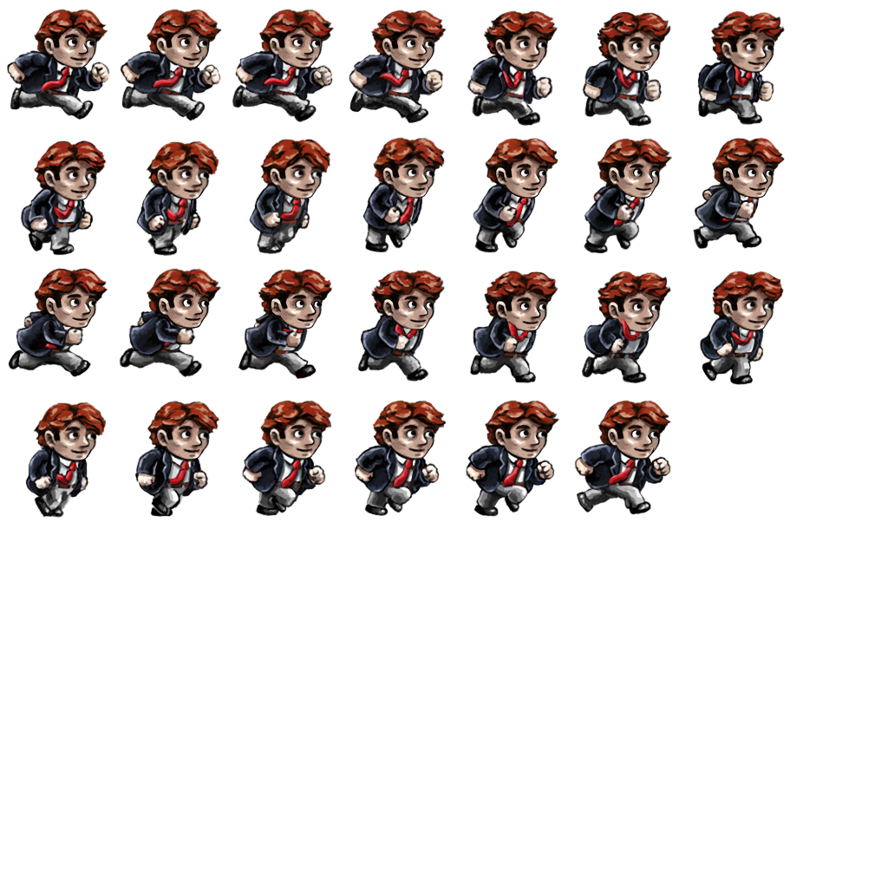
Textures & Sprites

Slide 27
Textures & Sprites
Sprites can be set up in a variety of ways:
Single Sprites
Animated Sprites
Sliced Sprites

Slide 28
Single Sprites
Static 2D images, meant to depict content that does not flip-book animate. Use the Single Sprite setting in the Inspector.
Useful for background terrain, static objects, UI elements.

Slide 29
Animated Sprites
Can be a Sprite Sheet or a collection of Single Sprites. Animates at a specified frame-rate by cycling through designated sprites.
GameObjects can trigger many animations using the Animator component.
Useful for: players, enemies, any interactive object

Slide 30
Sliced Sprites
Sliced Sprites are a way of using a single image to declare a variable-sized surface.
Define the sides, top, bottom and filled area, and you can create a tiling surface that scales without deformation or skewing
Useful for: UI dialog boxes, terrain

Slide 31
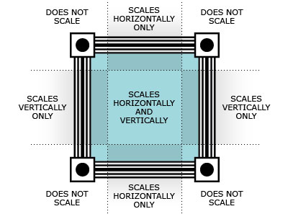
Sliced Sprites

Slide 32
Instantiating Sprites
Like everything else, sprite rendering is done through Components!
SpriteRenderer
Sprites can be created via the Toolbar or Hierarchy Window (Create -> 2D Object -> Sprite)

Slide 33
Instantiating Sprites
If you’re looking to create an animated sprite there are multiple ways of going about it:
Single Sprite Instancing
Sprite Sheet Instancing
*DEMO*

Slide 34
2D Collision System & Physics
Unity has TWO physics engines!
PhysX vs. Box2D
2D pipeline leverages Box2D, an open-source physics engine optimized for 2D interactions. Used in numerous titles across all platforms since 2001 (*I’ve used it in over 15 titles)

Slide 35
2D Collision System & Physics
Naming conventions remain the same as the 3D counterpart, but with “2D” added:
I.e. BoxCollider2D, Rigidbody2D, etc.

Slide 36
2D Collision System & Physics
There exist some quirks in Box2D that don’t exist in PhysX
Notably, KINEMATIC BODIES DO NOT COLLIDE WITH NON-DYNAMIC BODIES

Slide 37
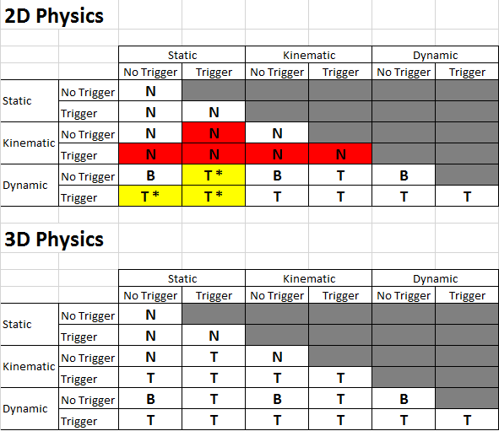
2D Collision System & Physics

Slide 38
Unity’s UI System!
As of Unity 4.6, it now ships with a robust and very powerful UI system
Based around core Components: Canvas, RectTransform, Visual Components, Interaction Components

Slide 39
Canvas
Container for all UI GameObjects.
Determines rendering method, layout and scaling of UI elements
All dimensions are specified in pixel-space relative to the Canvas settings

Slide 40
RectTransform
Special sub-class of Transform.
Allows for finer manipulation of UI elements, anchoring, and width/height specification.
Data can be modified in Scene view using Rect Transform Tool

Slide 41
PONG!
I’ve gone ahead and pre-made a clone of Pong!
Learning from what I’ve done, you’re going to re-create it and extend it!

Slide 42

Q & A!
Julian Spillane
julian@bitmakerlabs.com
@JulianSpillane

